Slide 1




Combining Data Structures
Choosing a Data Structure
Efficiency
SoftUni Team
Technical Trainers
Software University
http://softuni.bg

Slide 2

Table of Contents
Classical Collection Data Structures – Summary
Linear Data Structures
Balanced Binary Search Trees
Hash Tables
Choosing a Collection Data Structure
Combining Data Structures

Slide 3
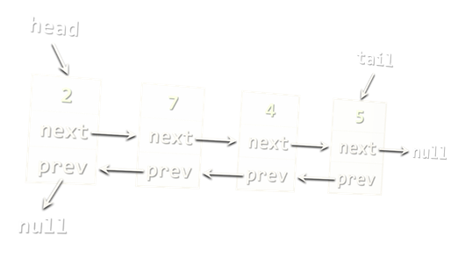
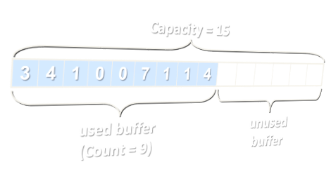
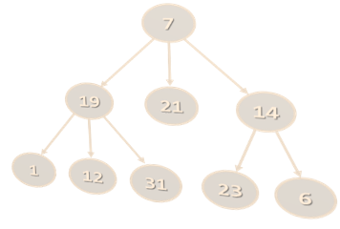
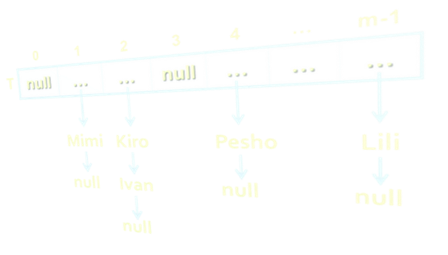
Choosing the Right DS
Lists vs. Hash Tables vs. Balanced Trees

Slide 4
Choosing a Collection - Array
Array (T[])
Use when fixed number of elements need processing by index
No resize → for fixed number of elements only
Add / delete needs creating a new array + move O(n) elements
Compact and lightweight
Data Structure | Add | Find | Delete | Get-by-index
Static array: T[] | O(n) | O(n) | O(n) | O(1)

Slide 5
Choosing a Collection – Array Based List
Resizable array-based list (List<T>)
Use when elements should be fast added and processed by index
Add (append to the end) has O(1) amortized complexity
The most-often used collection in programming
Data Structure | Add | Find | Delete | Get-by-index
Auto-resizable array-based list: List<T> | O(1) | O(n) | O(n) | O(1)

Slide 6
Choosing a Collection – Linked List
Doubly-linked list (LinkedList<T>)
Use when elements should be added at the both sides of the list
Use when you need to remove by a node reference
Otherwise use resizable array-based list (List<T>)
Data Structure | Add | Find | Delete | Get-by-index
Double-linked list: LinkedList<T> | O(1) | O(n) | O(n) | O(n)

Slide 7
Choosing a Collection – Stack
Stack (Stack<T>)
Use to implement LIFO (last-in-first-out) behavior
List<T> could also work well
Data Structure | Add | Find | Delete | Get-by-index
Stack: Stack<T> | O(1) | - | O(1) | -

Slide 8
Choosing a Collection – Queue
Queue (Queue<T>)
Use to implement FIFO (first-in-first-out) behavior
LinkedList<T> could also work well
Data Structure | Add | Find | Delete | Get-by-index
Queue: Queue<T> | O(1) | - | O(1) | -

Slide 9
Choosing a Collection – Map
Hash-table-based map (Dictionary<K,V>)
Fast add key-value pairs + fast search by key – O(1)
Keys have no particular order
Keys should implement GetHashCode(…) and Equals(…)
Data Structure | Add | Find | Delete | Get-by-index
Hash-table: Dictionary<K,V> | O(1) | O(1) | O(1) | -

Slide 10
Choosing a Collection – Tree Map
Balanced tree-based map (OrderedDictionary<K,V>)
Elements are ordered by key
Fast add key-value pairs + fast search by key + fast sub-range
Keys should be IComparable<T>
Balanced trees → slower than hash-tables: O(log n) vs. O(1)
Data Structure | Add | Find | Delete | Get-by-index
Balanced tree-based dictionary: SortedDictionary<K,V> | O(log n) | O(log n) | O(log n) | -

Slide 11
Choosing a Collection – Multi Map
Hash-table-based multi-dictionary (MultiDictionary<K,V>)
Fast add key-value + fast search by key + multiple values by key
Add by existing key appends a new value for the same key
Keys have no particular order
Data Structure | Add | Find | Delete | Get-by-index
Hash-table-based multi-dictionary: MultiDictionary<K,V> | O(1) | O(1) | O(1) | -

Slide 12
Choosing a Collection – Tree Multi Map
Tree-based multi-dictionary (OrderedMultiDictionary<K,V>)
Keys are ordered by key
Fast add key-value + fast search by key + fast sub-range
Add by existing key appends a new value for the same key
Data Structure | Add | Find | Delete | Get-by-index
Tree-based multi-dictionary: SortedDictionary<K,V> | O(log n) | O(log n) | O(log n) | -

Slide 13
Choosing a Collection – Hash Set
Hash-table-based set (HashSet<T>)
Unique values + fast add + fast contains
Elements have no particular order
Elements should implement GetHashCode(…) and Equals(…)
Data Structure | Add | Find | Delete | Get-by-index
Hash-table-based set: HashSet<T> | O(1) | O(1) | O(1) | -

Slide 14
Choosing a Collection – Tree Set
Balanced tree-based set (SortedSet<T>)
Unique values + sorted order
Fast add + fast contains + fast sub-range
Elements should be IComparable<T>
Data Structure | Add | Find | Delete | Get-by-index
Balanced tree-based set: SortedSet<T> | O(log n) | O(log n) | O(log n) | -

Slide 15
Choosing a Collection – Hash Bag
Hash-table-based bag (Bag<T>)
Bags allow duplicates
Fast add + fast find + fast contains
Elements have no particular order
Data Structure | Add | Find | Delete | Get-by-index
Hash-table-based bag: Bag<T> | O(1) | O(1) | O(1) | -

Slide 16
Choosing a Collection – Tree Bag
Balanced tree-based bag (SortedBag<T>)
Allow duplicates, sorted order
Fast add + fast find + fast contains
Access by sorted index + extract sub-range
Data Structure | Add | Find | Delete | Get-by-index
Balanced tree-based bag: OrderedBag<T> | O(log n) | O(log n) | O(log n) | -

Slide 17
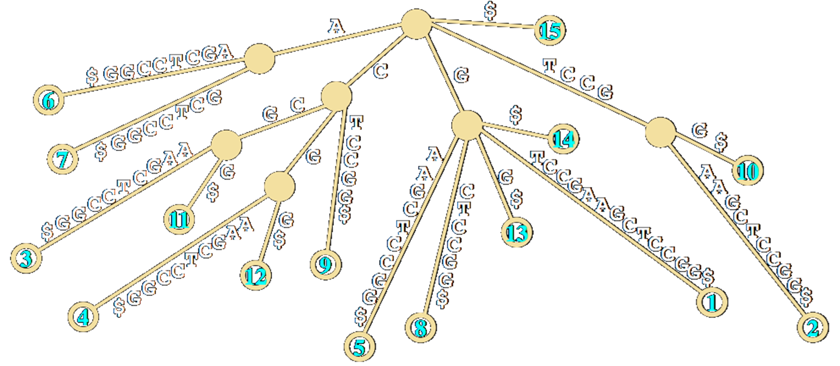
Choosing a Collection – Special DS
Priority Queue (Heap) – fast max/min element
Rope – fast add/remove by index
Prefix tree (Trie) – fast prefix search
Suffix tree – fast suffix search
Interval tree – fast interval search
K-d trees, Quad trees – fast geometric distance search

Slide 18
Data Structure Efficiency – Comparison
Data Structure | Add | Find | Delete | Get-by-index
Static array: T[] | O(n) | O(n) | O(n) | O(1)
Double-linked list: LinkedList<T> | O(1) | O(n) | O(n) | O(n)
Auto-resizable array-based list: List<T> | O(1) | O(n) | O(n) | O(1)
Stack: Stack<T> | O(1) | - | O(1) | -
Queue: Queue<T> | O(1) | - | O(1) | -

Slide 19
Data Structure Efficiency – Comparison (2)
Data Structure | Add | Find | Delete | Get-by-index
Hash-table: Dictionary<K,V> | O(1) | O(1) | O(1) | -
Balanced tree-based dictionary: SortedDictionary<K,V> | O(log n) | O(log n) | O(log n) | -
Hash-table-based set: HashSet<T> | O(1) | O(1) | O(1) | -
Balanced tree-based set: SortedSet<T> | O(log n) | O(log n) | O(log n) | -

Slide 20
Data Structure Efficiency – Comparison (3)
Data Structure | Add | Find | Delete | Get-by-index
Hash-table-based multi-dictionary: MultiDictionary<K,V> | O(1) | O(1) | O(1) | -
Tree-based multi-dictionary: SortedDictionary<K,V> | O(log n) | O(log n) | O(log n) | -
Hash-table-based bag: Bag<T> | O(1) | O(1) | O(1) | -
Balanced tree-based bag: OrderedBag<T> | O(log n) | O(log n) | O(log n) | -

Slide 21
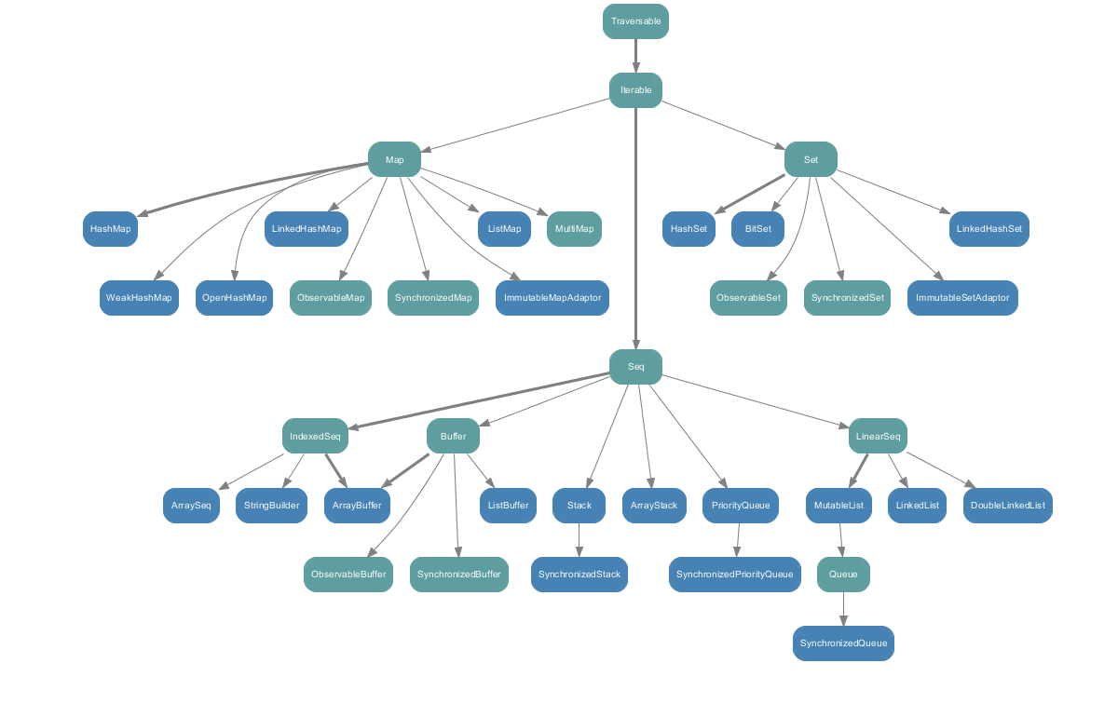
Java – Collections/Guava APIs
All commonly used collections
java.util.Collections
com.google.common.collect

Slide 22

Combining Data Structures

Slide 23
Combining Data Structures
Many scenarios → combine several DS
No ideal DS → choose between space and time
For example, we can combine:
A hash-table for fast search by key₁ (e.g. name)
A hash-table for fast search by {key₂ + key₃} (e.g. name + town)
A balanced search tree for fast extract-range(start_key … end_key)
A rope for fast access-by-index
A balanced search tree for fast access-by-sorted-index

Slide 24
Problem: Collection of Persons
Design a data structure that efficiently implements:
Operation | Return Type
Add(email, name, age, town) | bool – unique email
Find(email) | Person or null
Delete(email) | bool
Find-All(email_domain) | IEnumerable<P> – sorted by email
Find-All(name, town) | IEnumerable<P> – sorted by email
Find-All(start_age, end_age) | Ienumerable<P> – sorted by age, email
Find-All(start_age, end_age, town) | Ienumerable<P> – sorted by age, email

Slide 25
List Based Solution
List based solution – single list for all operations
Easy to implement
Easy to achieve correct behavior
Useful for creating unit tests
0 | 1 | 2 | … | n-1
Mimi | Jana | Acho | … | Lili

Slide 26
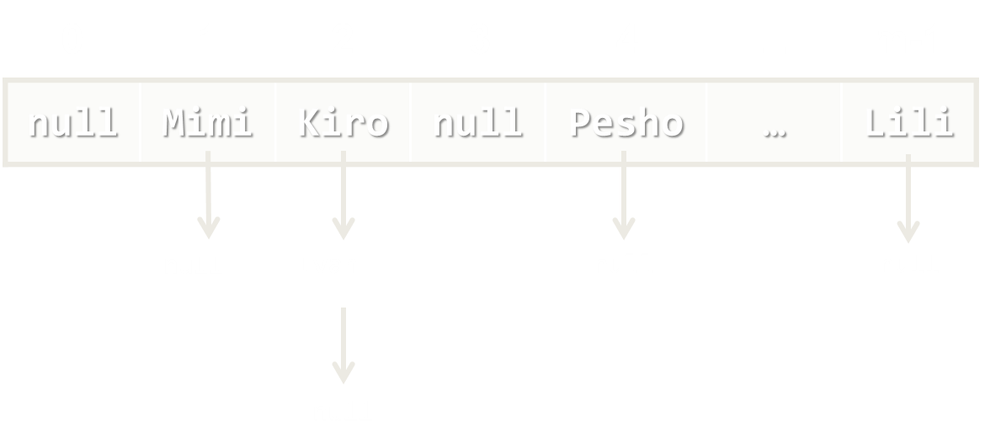
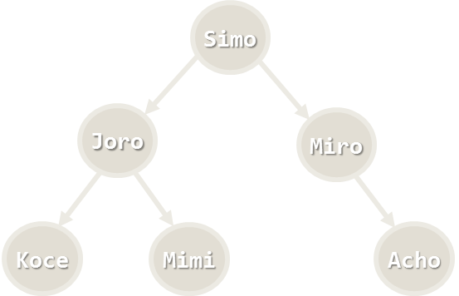
Solution: Add Person
bool Add(email, name, age, town)
Create a Person object to hold { email + name + age + town }
Add the new person to all underlying data structures
Add

Slide 27
Solution: Find by Email
Person Find(email)
Use a hash-table to map { email → person }
Complexity – O(1)

Slide 28
Solution: Delete
bool Delete(email)
Find the person by email in the underlying hash-table
Delete the person from all underlying data structures
Complexity – O(log n)
Delete

Slide 29
Solution: Find by Domain
IEnumerable<Person> Find-All(email_domain)
Use a hash-table to map {email_domain → SortedSet<Person>}
Get email_domain by the email when adding persons
Complexity – O(1)
abv.bg
gmail.com
hotmail.com

Slide 30
Solution: Find by Name + Town
IEnumerable<Person> Find-All(name, town)
Combine the keys {name + town} into a single string name_town
Use a hash-table to map {name_town → SortedSet<Person>}
Complexity – O(1)
Pesho VT
Mimi SF
Jana PLD

Slide 31
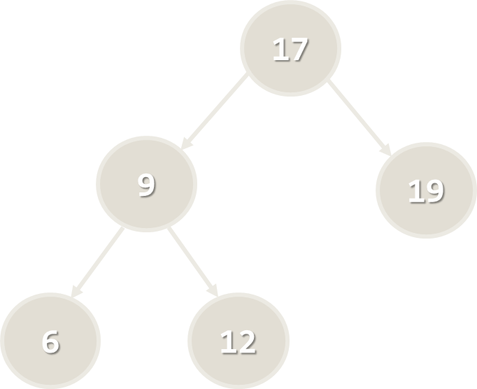
Problem: Collection of Persons
IEnumerable<Person> Find-All(start_age, end_age)
Use a balanced search tree to keep all persons ordered by age:
OrderedDictionary<age, SortedSet<Person>>
Use the Range(start_age, end_age) operation in the tree
Complexity – O(log n)

Slide 32
Problem: Collection of Persons
Ienumerable<Person> Find-All(start_age, end_age, town)
Use a hash-table to map {town → persons_by_ages}
People_by_ages can be stored as balanced search tree:
OrderedDictionary<age, SortedSet<Person>>
VT
SF
PLD

Slide 33

Lab Exercise
Collection of People

Slide 34
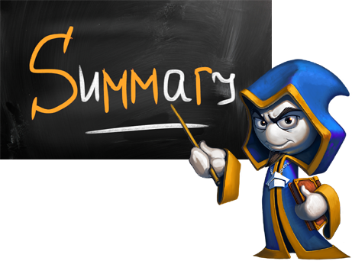
Summary
Different data structures have different efficiency for their operations
List-based collections provide fast append and access-by-index, but slow find and delete
The fastest add / find / delete structure is the hash table – O(1) for all operations
Balanced trees are ordered – O(log n) for add / find / delete + range(start, end)
Combining data structures is often essential
E.g. combine multiple hash-tables to find by different keys

Slide 35







Combining Data Structures
https://softuni.bg/opencourses/data-structures

Slide 36
License
This course (slides, examples, labs, videos, homework, etc.) is licensed under the "Creative Commons Attribution-NonCommercial-ShareAlike 4.0 International" license
Attribution: this work may contain portions from
"Fundamentals of Computer Programming with C#" book by Svetlin Nakov & Co. under CC-BY-SA license
"Data Structures and Algorithms" course by Telerik Academy under CC-BY-NC-SA license

Slide 37





Trainings @ Software University (SoftUni)
Software University – High-Quality Education, Profession and Job for Software Developers
softuni.bg
Software University Foundation
softuni.org
Software University @ Facebook
facebook.com/SoftwareUniversity
Software University Forums
forum.softuni.bg

